Slide 1
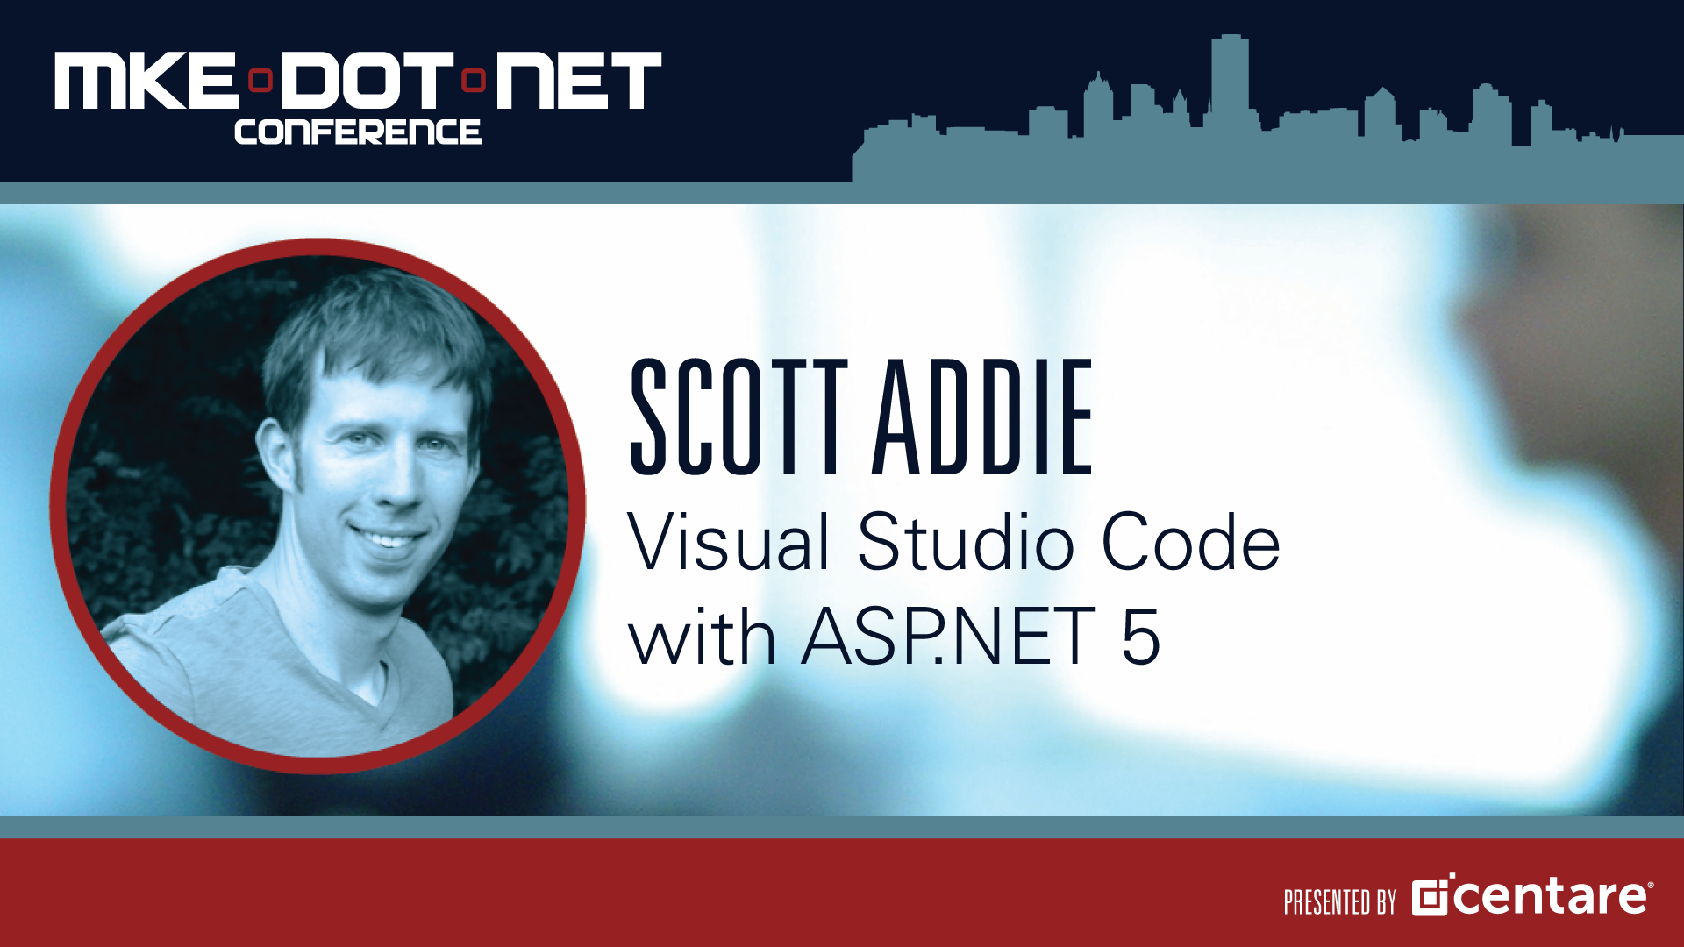

Slide 2

Getting Started with ASP.NET 5 in VS Code
November 14, 2015

Slide 3





About me and this talk
Scott Addie
.NET Solutions Architect
MCSD (Web Apps)
Visual Studio Code Insider
GitHub.com/scottaddie/vscode-aspnet5
ScottAddie.com
@Scott_Addie
LinkedIn.com/in/scottaddie

Slide 4
New Terminology
DNVM (.NET Version Manager)
DNX (.NET Execution Environment)
DNU (.NET Development Utility)
Installation of DN* Tooling: http://bit.ly/1YaRWJY

Slide 5



New Choices
ASP.NET 5 App
DNX
Full .NET Framework
dnx451, dnx452, dnx46
.NET Core
dnxcore50
Both
dnx46 & dnxcore50

Slide 6
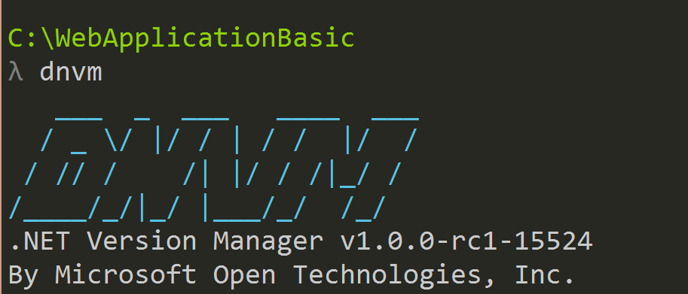
DNVM
Framework versioning manager
Registers frameworks in user profile
%USERPROFILE%\.dnx\runtimes
2 runtime types:
Clr
rely on .NET being installed on machine
CoreClr
can be deployed w/ app

Slide 7
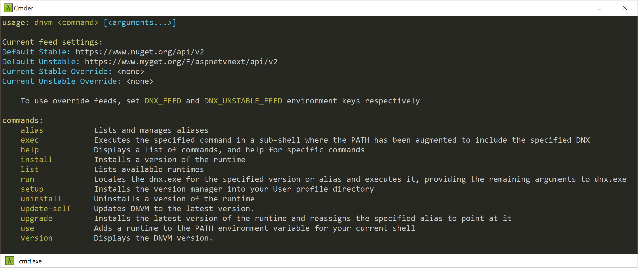
DNVM
Framework Inventory
> dnvm list
Select Framework
> dnvm use
Delete Framework
> dnvm uninstall
Install Latest DNVM
> dnvm update-self

Slide 8
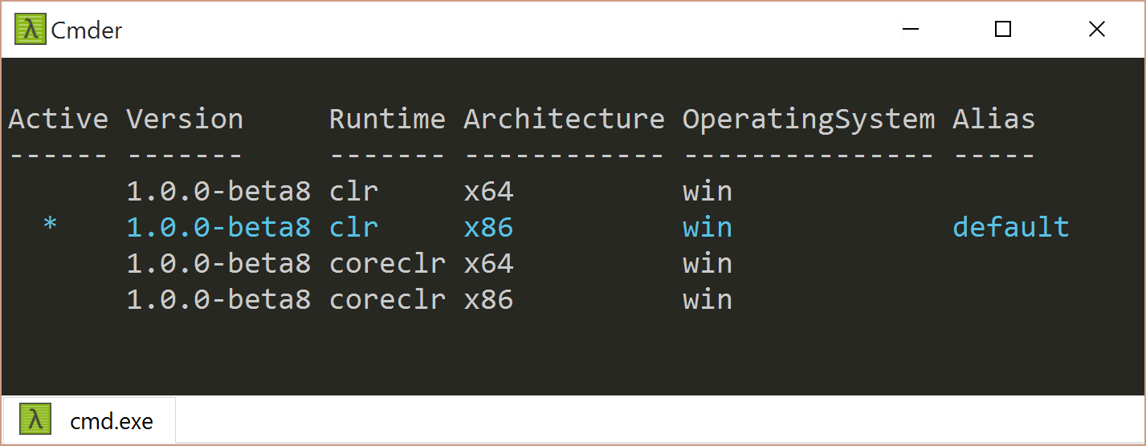
DNVM – View Framework Options
> dnvm list

Slide 9
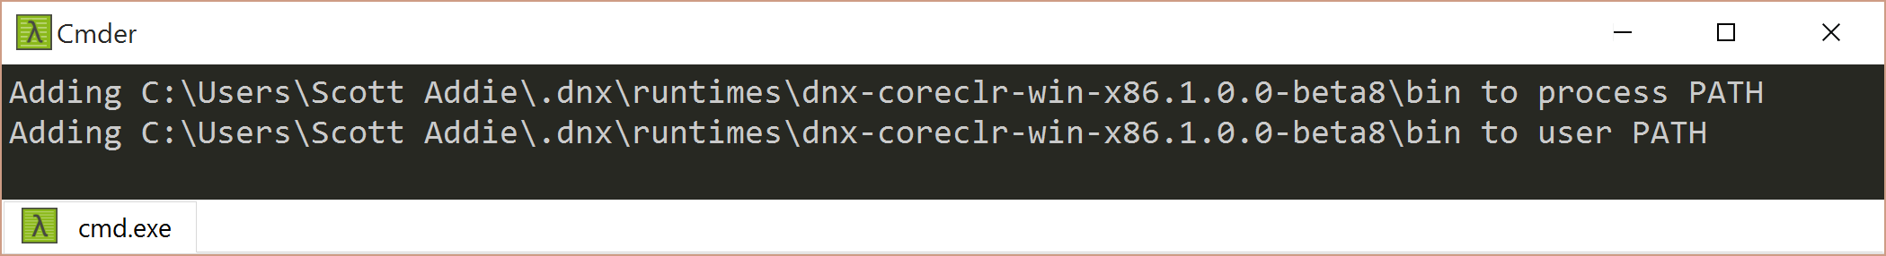
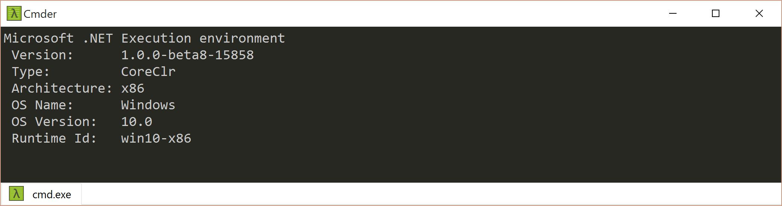
DNVM – Set Default Runtime
> dnvm use 1.0.0-beta8 –r coreclr –a x86 –p
> dnx --version

Slide 10
DNX
SDK & runtime environment
Builds & runs .NET apps on Windows, Mac, or Linux
Original intent = running xplat ASP.NET web apps
Can run other types of .NET apps (xplat console apps, etc.)

Slide 11
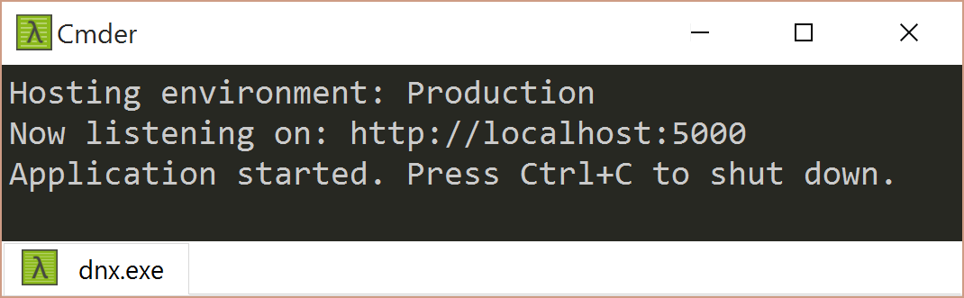
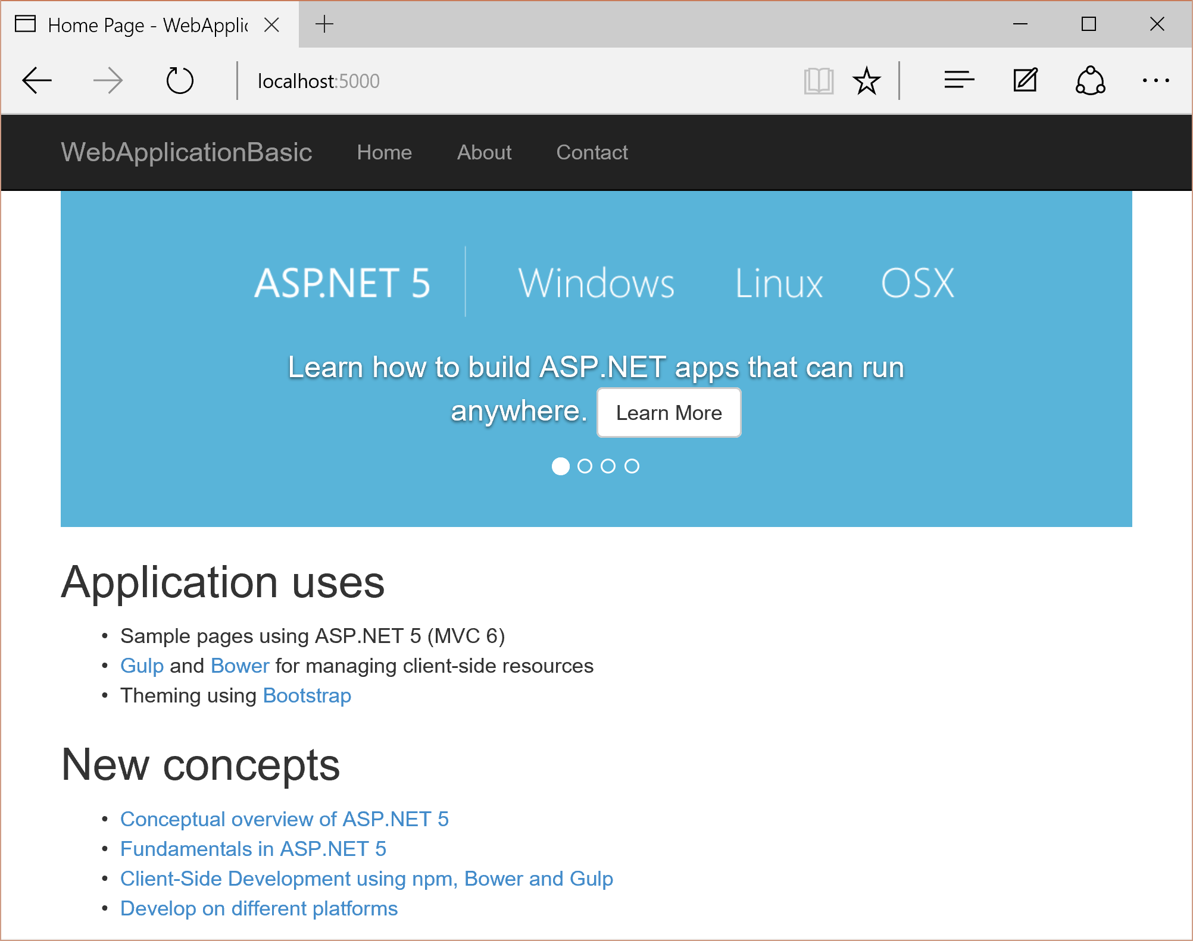
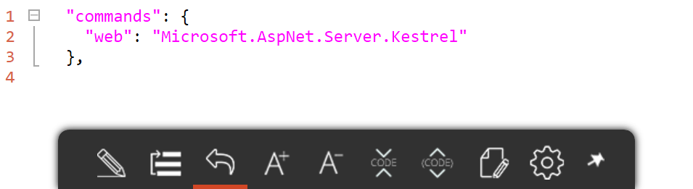
DNX – Start Web Server
project.json
> dnx web
Execute
Start
Browse

Slide 12
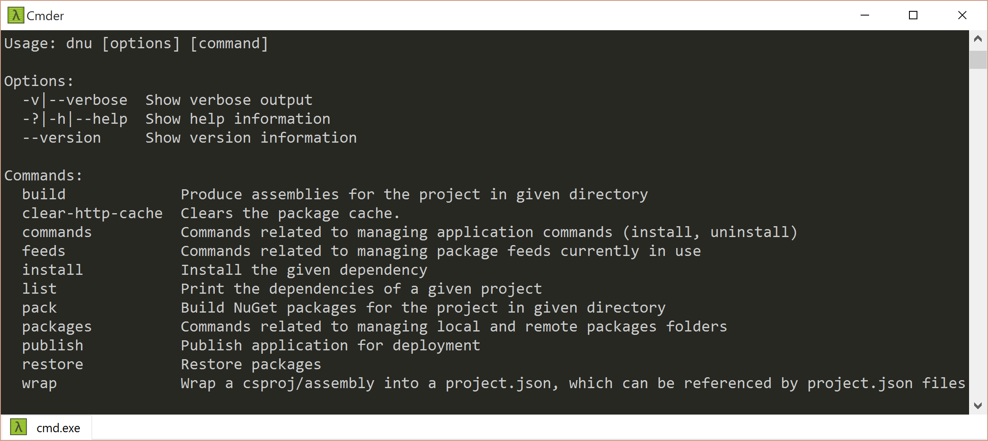
DNU
Restores
> dnu restore
Builds
> dnu build
Packages
> dnu pack
Publishes
> dnu publish

Slide 13
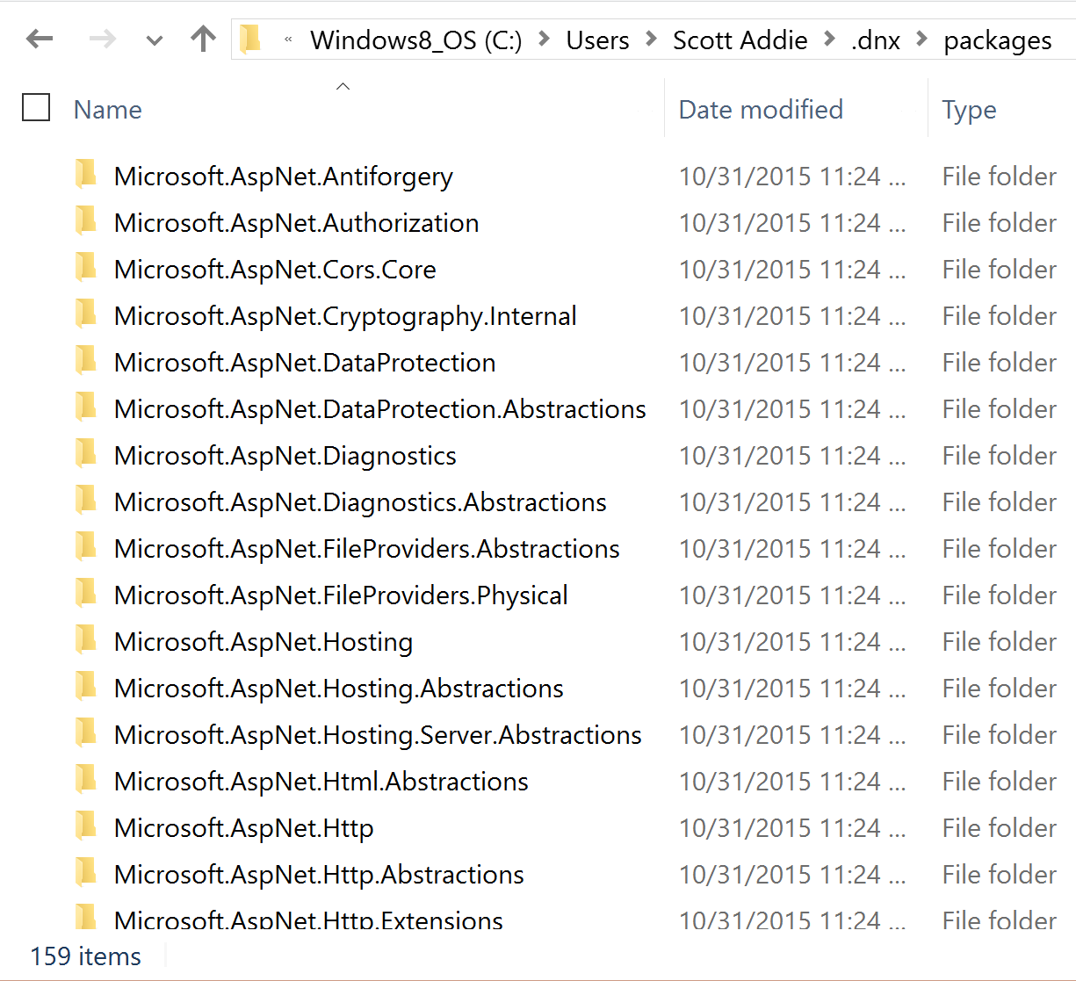
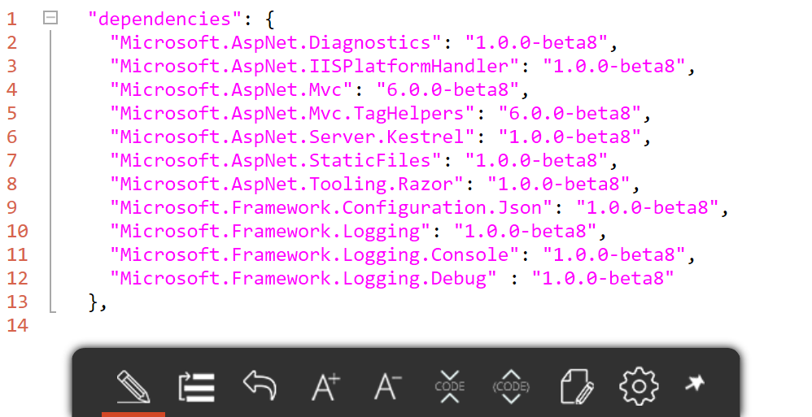
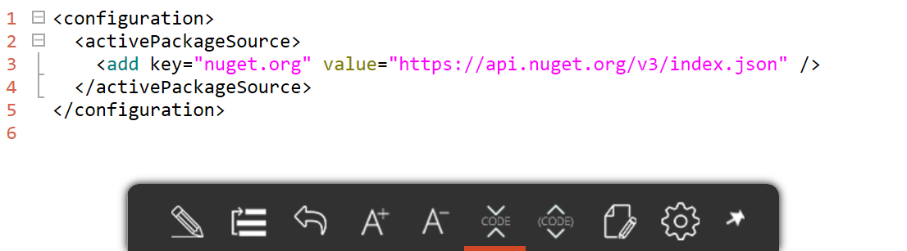
DNU – NuGet Package Restore
NuGet.config
Read
> dnu restore
Read
project.json
Install

Slide 14
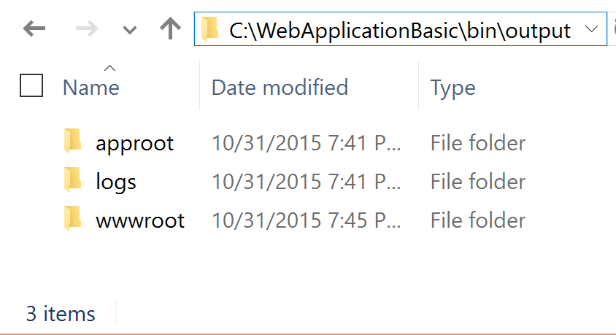
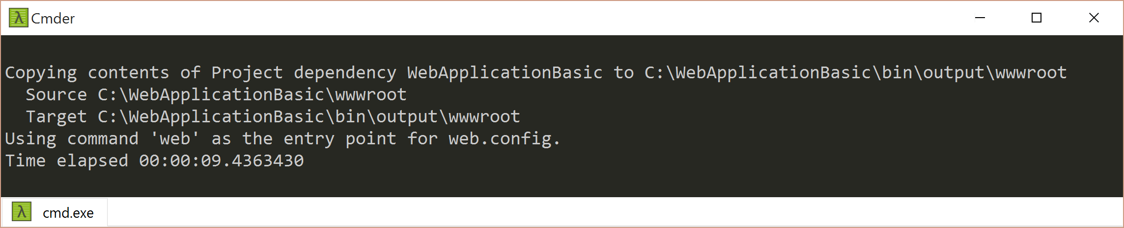
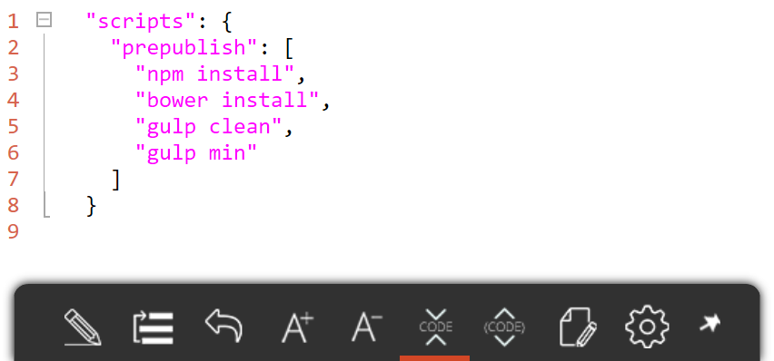
DNU – Publish
project.json
Execute
> dnu publish
Publish
Write

Slide 15
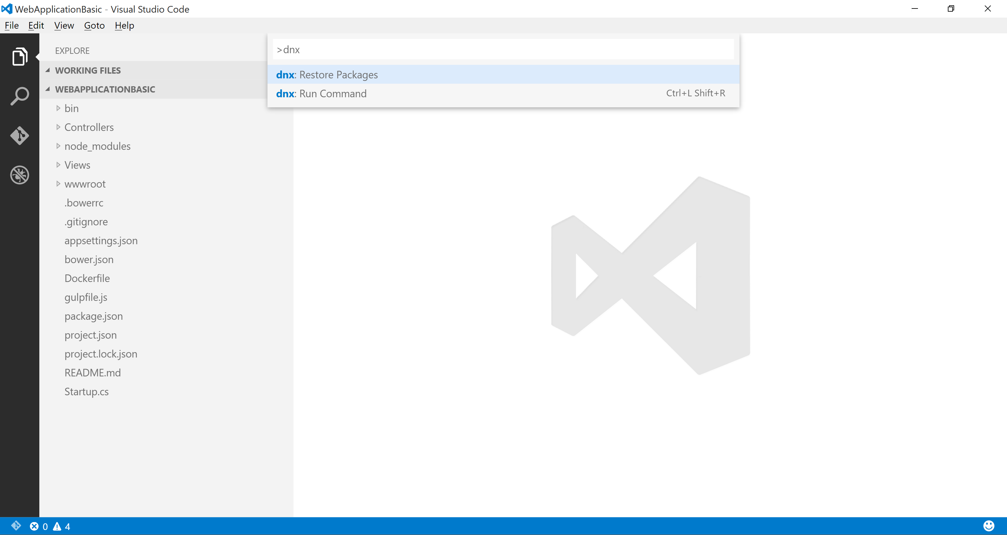
DN* Support in VS Code
Command Palette (F1)
> dnu restore
> dnx web

Slide 16
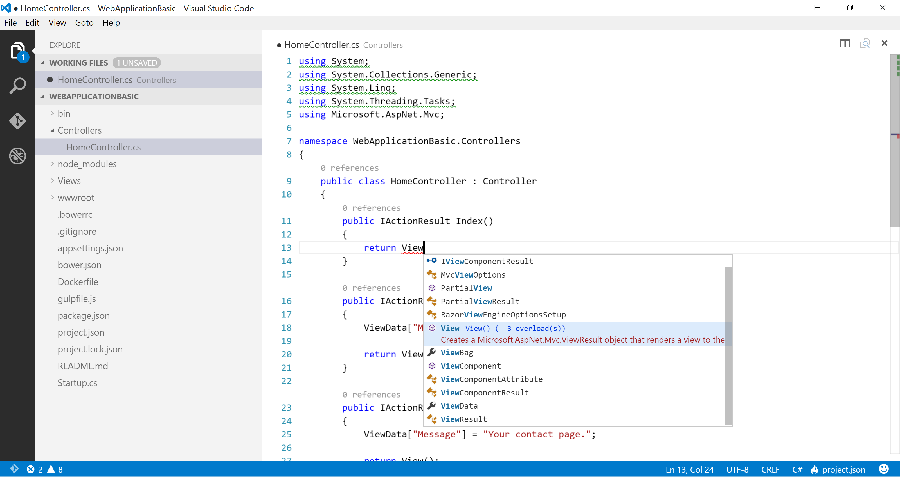
C# Support in VS Code
Unused References
Code Lens
IntelliSense
OmniSharp Integration

Slide 17



Scaffolding Support for VS Code
OmniSharp
Yeoman
generator-aspnet

Slide 18

> DN* Demo
ASP.NET 5 Web Application in VS Code

Slide 19
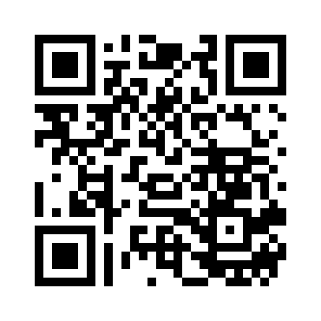
Resources
Scan QR for slides & code:
Official ASP.NET 5 docs
ASP.NET 5 Apps w/ VS Code
OmniSharp’s generator-aspnet
VS Code Pluralsight course
dnx-watch w/ VS Code

